Slide 1
Bike Sharing Demand
- Saranraj Kumar , MoTIS 9

Slide 2

Objective
Create a model to predict the number of bikes that will be rented at any given hour of the day.

Slide 3
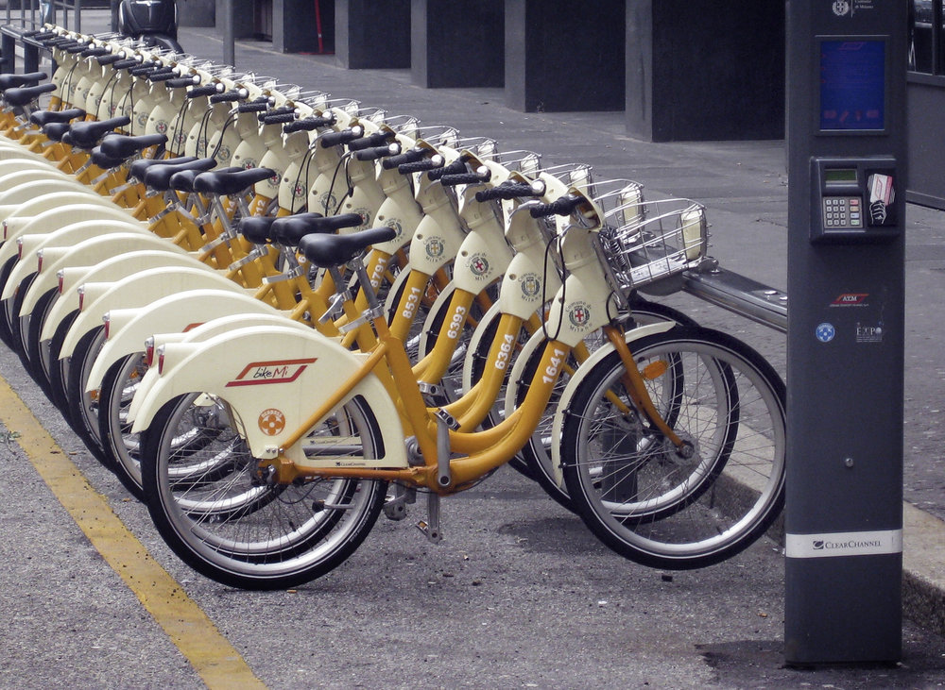
Bike Sharing System
Renting bicycles without ownership
Membership or Pay as you go basis
Pick bicycles from any kiosk in one location and return it to a Kiosk in another location.

Slide 4
Benefits
Efficient Inventory Management.
Increase/decrease the number of bikes during certain hours of the days , season and working/holiday.
Increase the customer satisfaction.

Slide 5
Data Source
The dataset was provided by Hadi Fanaee Tork using data from Capital Bikeshare.
Data : https://www.kaggle.com/c/bike-sharing-demand

Slide 6
Details of the dataset
Consists hourly rental data spanning two years.
The training set is comprised of the first 19 days of each month, while the test set is the 20th day to the end of the month.
Predict the total count of bikes rented during each hour for the last 10 days using information available for the first 20 days.
The trading data has 10866 observations of 12 variables
The test data has 6493 observations of 9 variables.

Slide 7
Data Fields
Variable | Type | Remarks
Date Time | Date time
Season | Integer | Spring, Summer, Fall, Winter
Holiday | Boolean | Holiday
Working day | Boolean | Working Day
Weather | Integer | Clear, Mist, Snow, Heavy Rain
Temp | Decimal | Celsius
Atemp | Decimal | Apparent Temp
Humidity | Integer | Humidity
Wind speed | Decimal | Air speed
Casual | Integer | Non-customer
Registered | Integer | Customer
Count | Integer | Number of bikes

Slide 8
Influences of Data
Hourly & Daily Trend
Season & Temperature
Humidity and wind speed
Registered and casual user details

Slide 9
Feature Engineering
No Missing value in the data set
Parsing the Date time
Splitting the Date time Colum into Days, Months, years and day of the week.
Removing the temperature
Grouping of peak timing

Slide 10
Additional Information
Traffic details
Users employment information

Slide 11
Algorithms
Random Forest
Linear Regression

Slide 12
Ethical Implications
Tracking the current location of the users
Selling data to Insurance companies

Slide 13
Thank You

